Slide 1

Skin cancer detection using Image Processing
Department Of Information Technology
Rajkiya Engineering College
Azamgarh, Uttar Pradesh 276201
Mentor:- Presented By:-
Dr. Tauseef Ahmad Abhishek Singh(1773613003)
Anurag Chaudhary(1773613011)
Nitin Gaur(1773613030)
Vishal Saraswat(1773613059)

Slide 2
Table of Content
Skin Cancer (overview)
Risk factors
Types of skin cancer
Malignant Melanoma
Objective
Different dataset available
Block Diagram
Libraries Used
Model Used
Workflow
Testing and Comparison
ROC curve and confusion matrix
Result sample
Reference

Slide 3
Skin Cancer
Skin cancer is the most commonly diagnosed cancer.
Skin cancers are either non-melanoma or melanoma.
Early detection and treatment can often lead to a highly favourable diagnosis
The visibility of the skin lesions increases the likelihood of early detection and diagnosis

Slide 4
Risk Factors for Skin Cancer
Damage in the ozone layer
Fair-skinned and fair-haired people due to insufficient skin pigmentation
Prolonged exposure to sun light.
Exposure to chemical pollutants(arsenic, nitrates, coal, tar and pitch, oils and paraffins)
History of x-ray therapy for acne or benign lesions
Scars from severe burns
Chronic skin irritations
Immunosuppression
Genetic factors

Slide 5
Types of skin cancers
The most common types of skin cancer are:
Basal Cell Carcinoma (BCC)
Squamous cell (epidermoid) carcinoma (SCC)
Malignant Melanoma

Slide 6
Malignant Melanoma
A malignant melanoma is a cancerous neoplasm in which abnormal melanocytes are present in the epidermis and the dermis (and sometimes the subcutaneous cells).
Most lethal of all the skin cancers
Most melanomas arise from cutaneous epidermal melanocytes

Slide 7
RISK FACTORS
The cause of malignant melanoma is unknown
Ultraviolet rays are strongly suspected, based on indirect evidence such as
The increased incidence of melanoma in countries near the equator
Family history

Slide 8
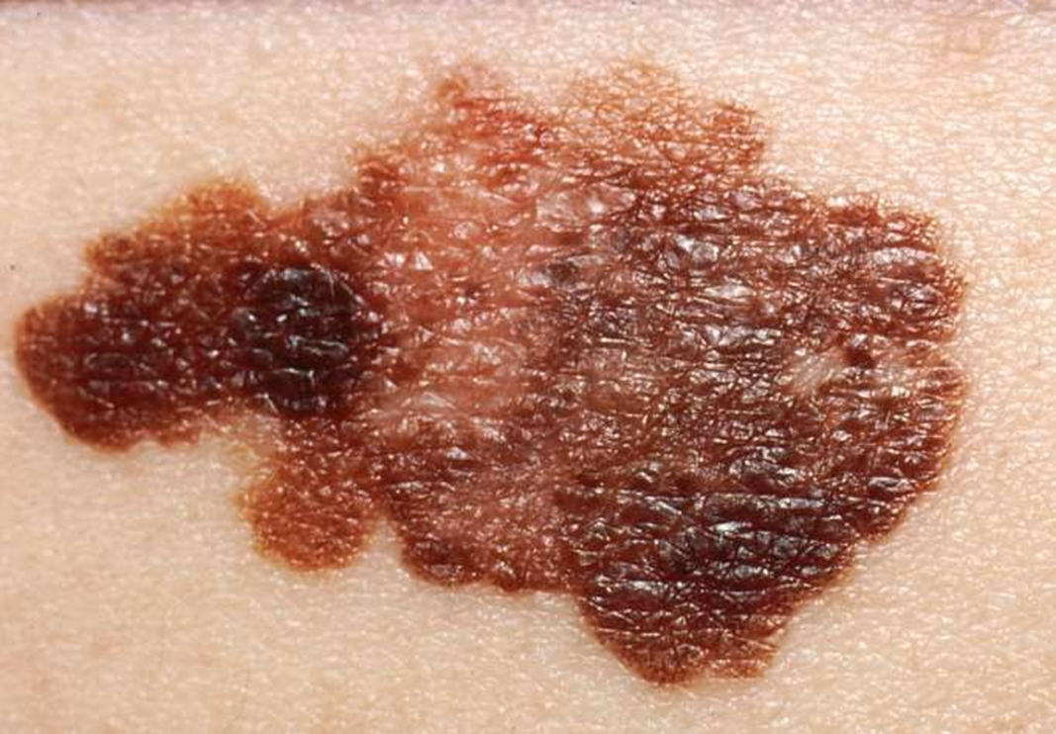
Sample Image

Slide 9
Objective
The objective of our work is detect to Melanoma Skin Cancer detection using image processing

Slide 10
Different types of Dataset Available
Database | Benign | Malignant
ISIC_UDA-2_1 | 23 | 37
ISIC_UDA-1_1 | 398 | 159
Skin Cancer: Malignant vs Benign | 1440 | 1197
HAM10000 | 174 | 326

Slide 11
GENERAL DIAGNOSIS BLOCK DIAGRAM
Data Collection
Preprocessing
Segmentation
Classification
Feature Extraction

Slide 12
MAJOR LIBRARIES USED
1. Pandas
2. Numpy
3. Matplotlib
4. Keras
5. Tensorflow
6. Sklearn

Slide 13
MODEL USED
1. CNN Model
2. ResNet 50

Slide 14
Workflow
Flow Chart
Sequence Diagram
Data Flow Diagram

Slide 15
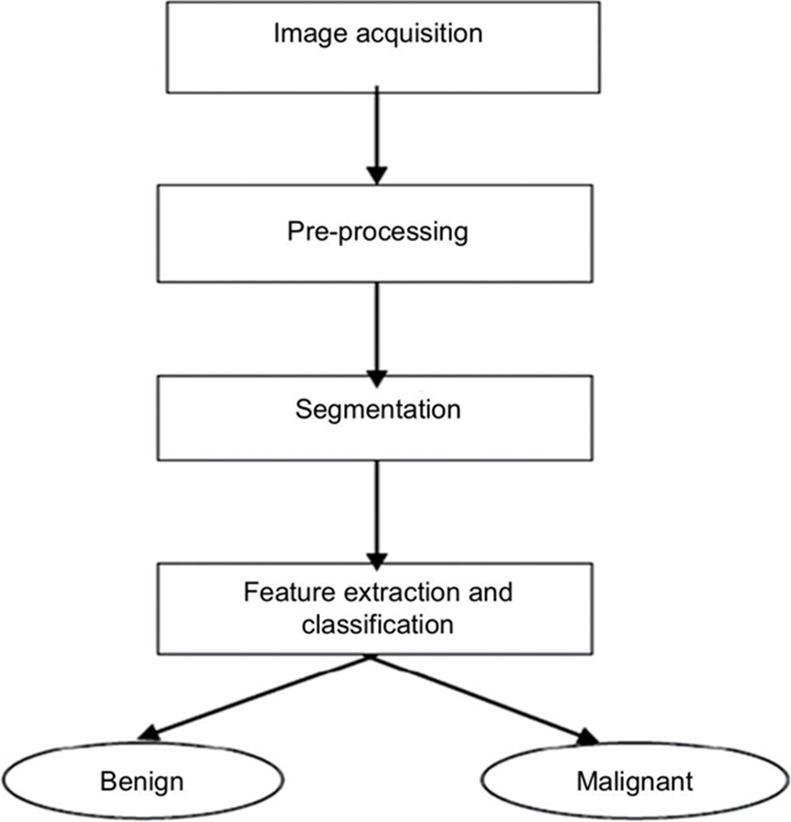
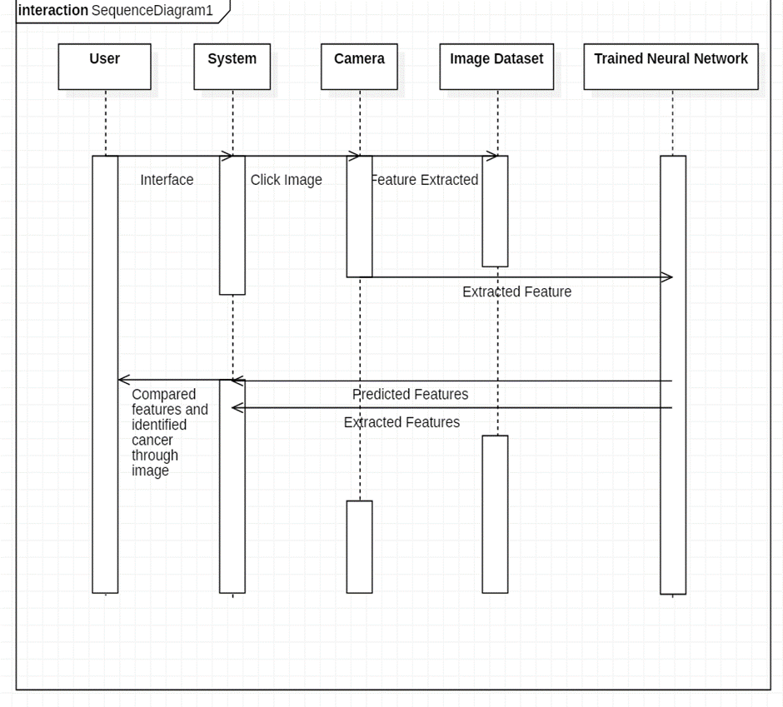
FLOW CHART
SEQUENCE DIAGRAM

Slide 16
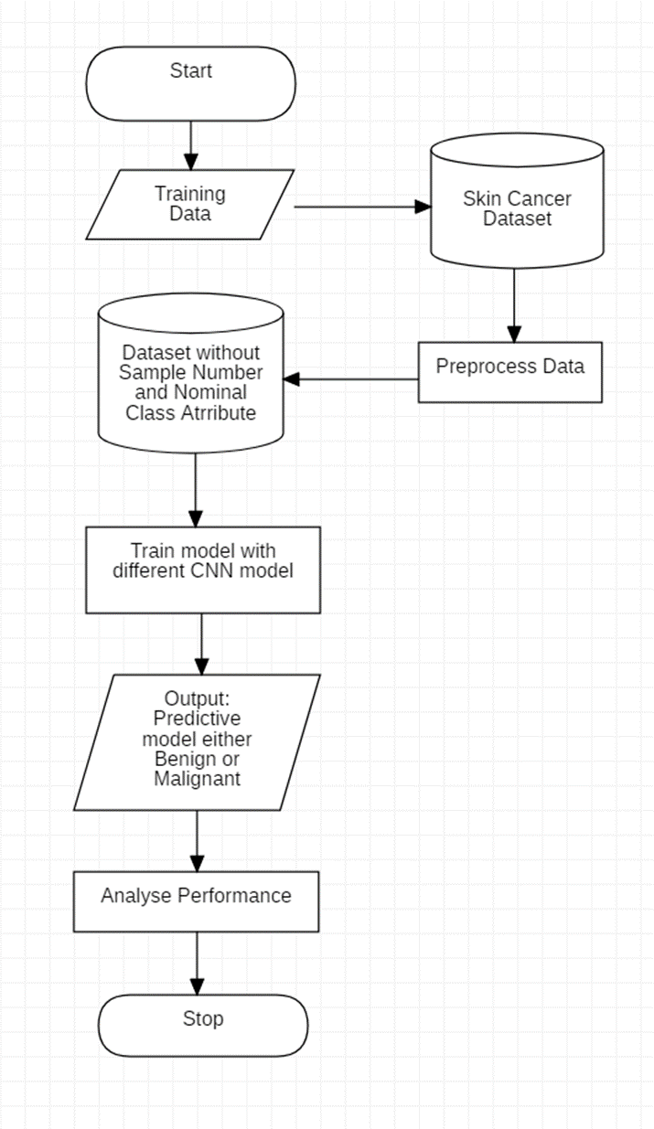
DATA FLOW DIAGRAM

Slide 17
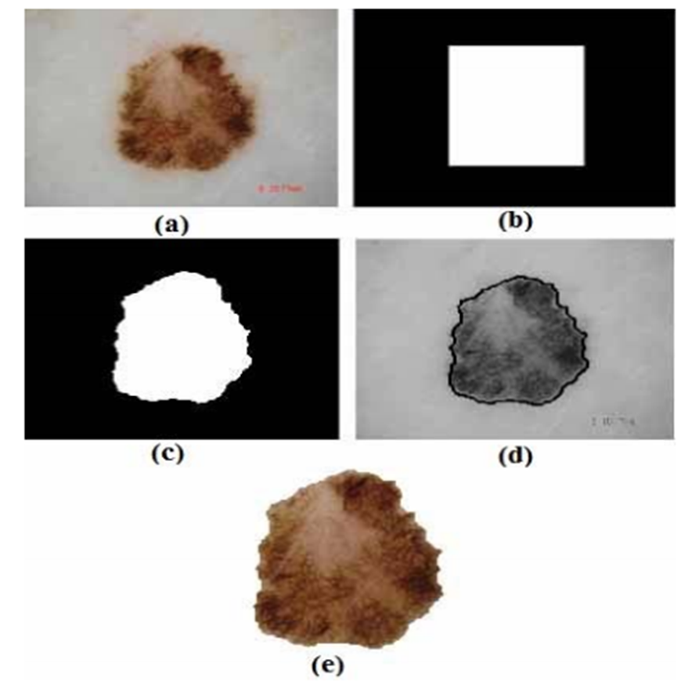
Preprocessing Images for malignant lesion
(a) Original Image
(b) Initial segmentation
(c) Active countor
model segmentation
(d) Border of the segmentation on gray scale image
(e) Colored ROI

Slide 18
CNN Model
The idea is to develop a simple CNN model from scratch, and evaluate the performance to set a baseline. The following steps to improve the model are:
Data augmentation: Rotations, noising, scaling to avoid overfitting
Transferred Learning: Using a pre-trained network construct some additional layer at the end to fine tuning our model.
Full training and Evaluation

Slide 19
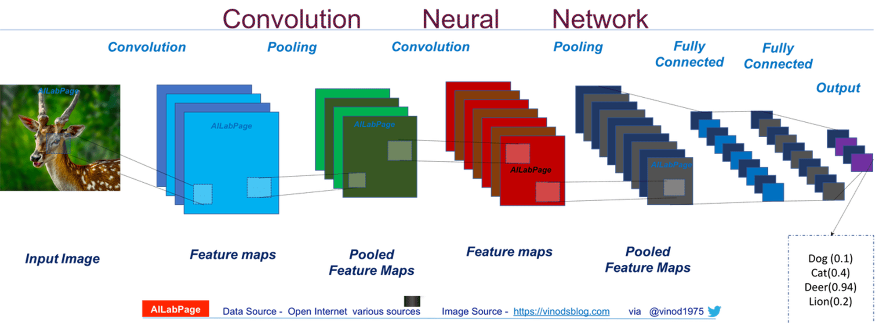
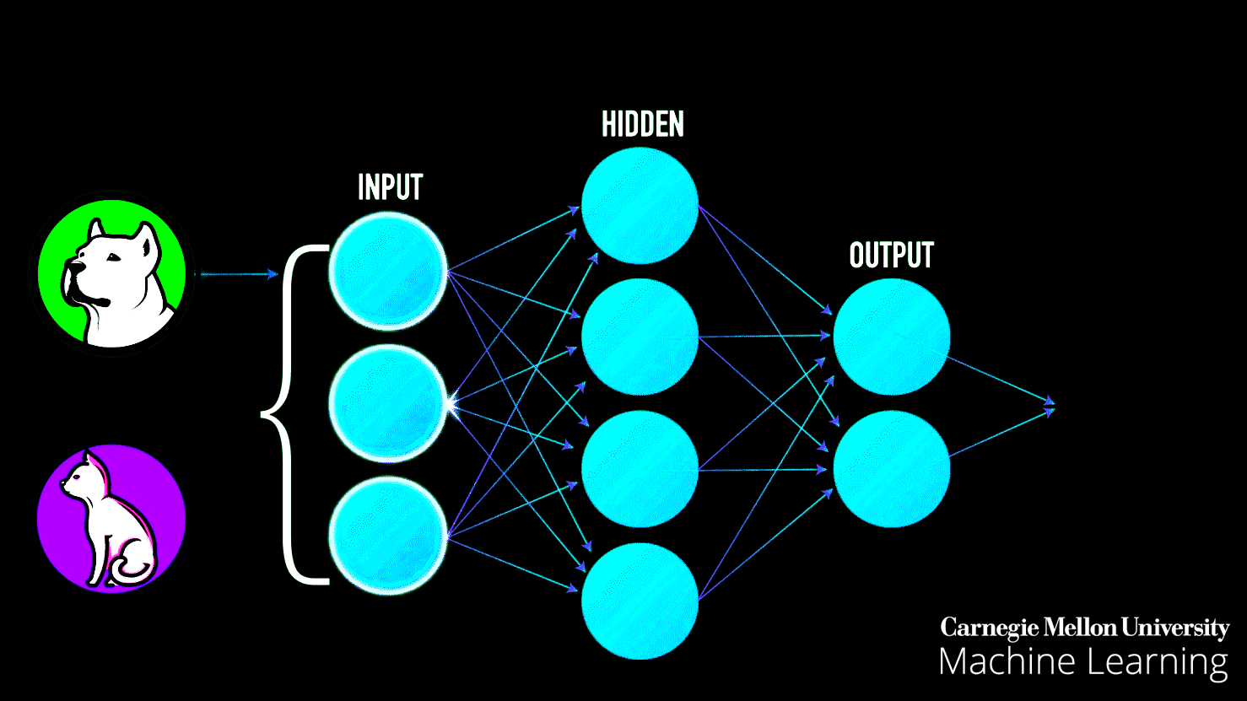
Sample of cnn working

Slide 20

Neural network with many convolutional layers

Slide 21
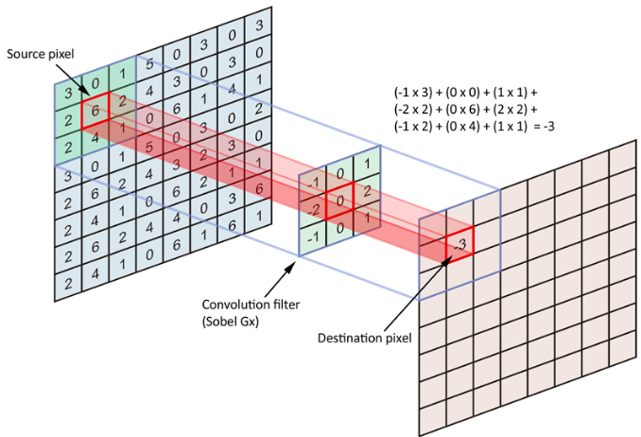

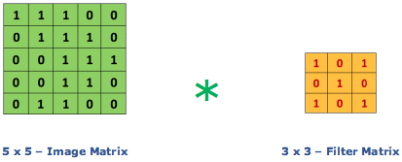
Image matrix multiplies kernel or filter matrix

Slide 22
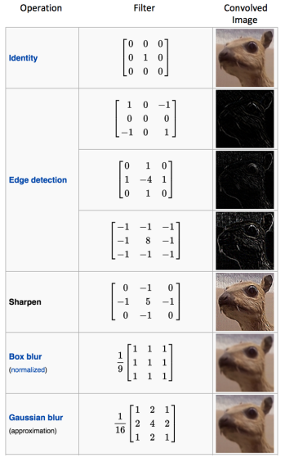
Some common filters

Slide 23
rESnet 50
ResNet-50 is a convolutional neural network that is 50 layers deep.
The ResNet-50(Residual Network) was introduced after CNN (Convolutional Neural Network). Additional layers are added to a DNN to improve accuracy and performance and are useful in solving complex problems.
Mostly in order to solve a complex problem, we stack some additional layers in the Deep Neural Networks which results in improved accuracy and performance.
ResNet-50 accuracy with 13 times fewer parameters and at 3 times speed better than rest of other model .

Slide 24
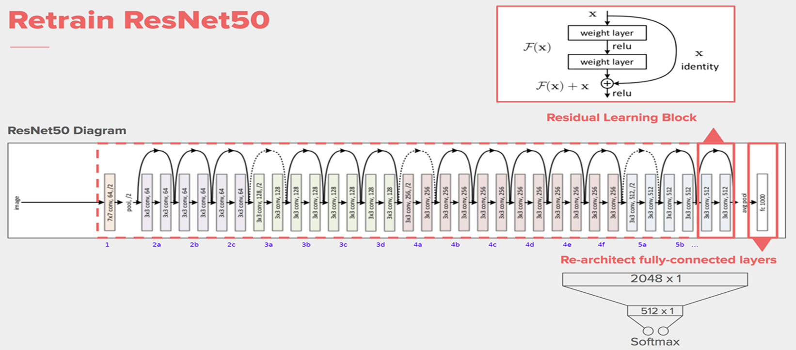

Slide 25
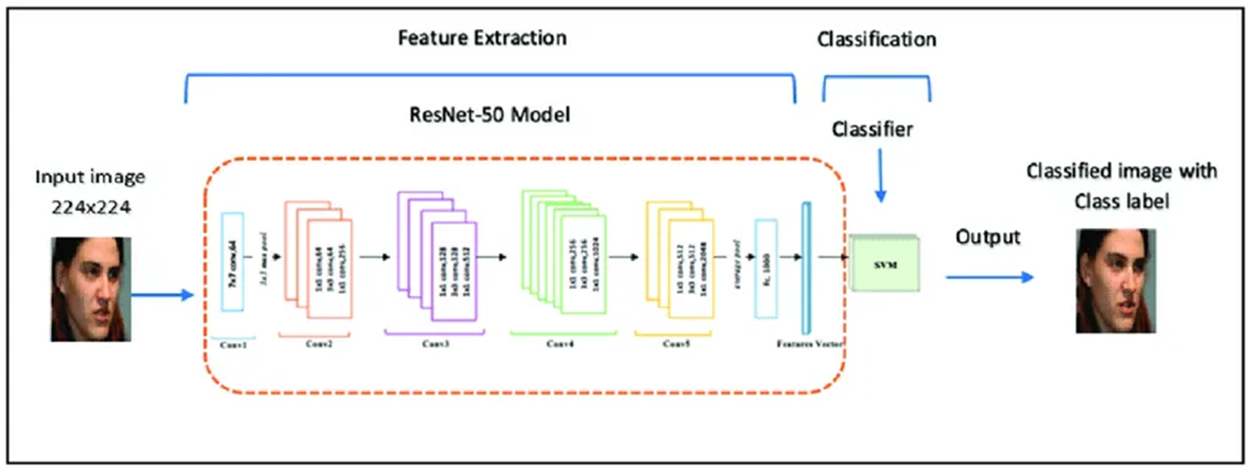

Slide 26
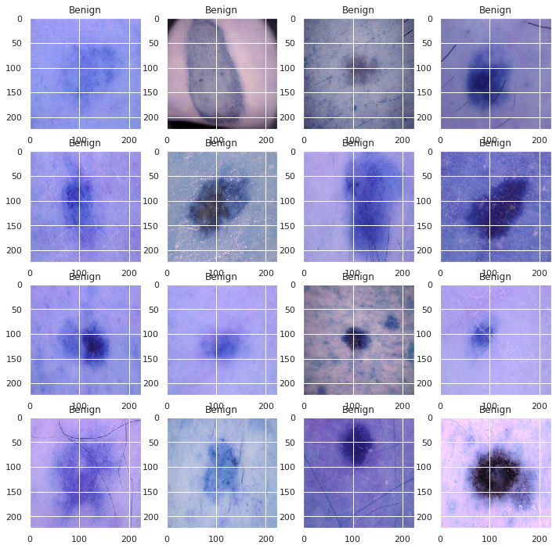
RESNET 50 IMPEMENTATION
SAMPLE IMAGE DATA

Slide 27
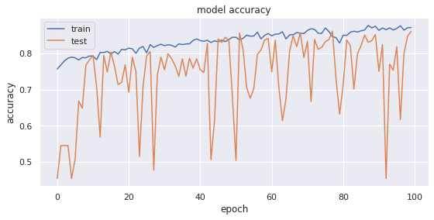
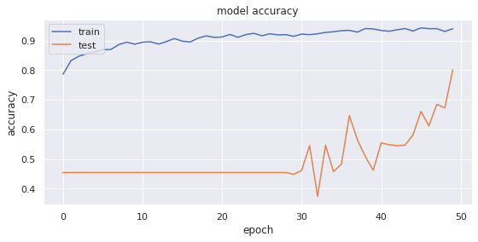
Comparison with other Model
Model Name | Accuracy | Precision | Recall | f1-score
CNN | 86.23 | 0.81 | 0.83 | 0.82
ResNet-50 | 90.45 | 0.83 | 0.88 | 0.85
VGG-16 | 72.12 | 0.62 | 0.71 | 0.69
CNN
ResNet 50

Slide 28
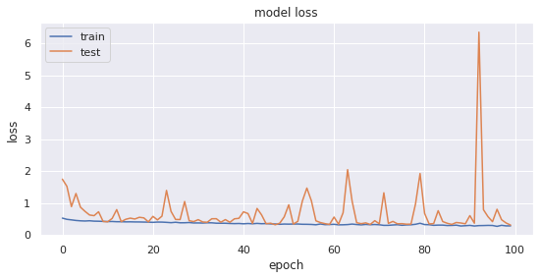
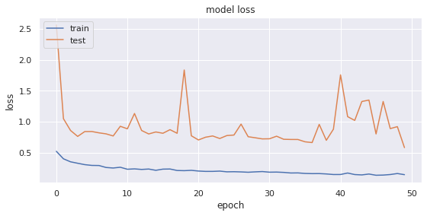
MODEL LOSS
CNN
ResNet 50

Slide 29
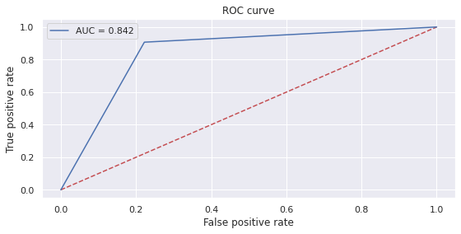
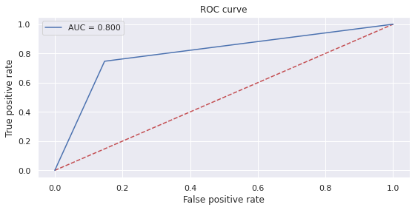
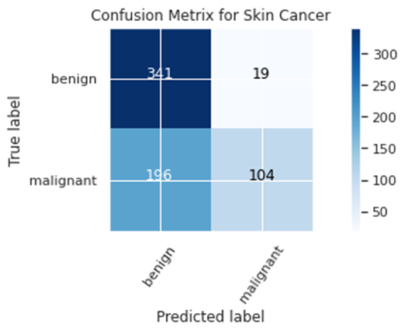
ROC CURVE
CNN
ResNet 50
Confusion matrix

Slide 30
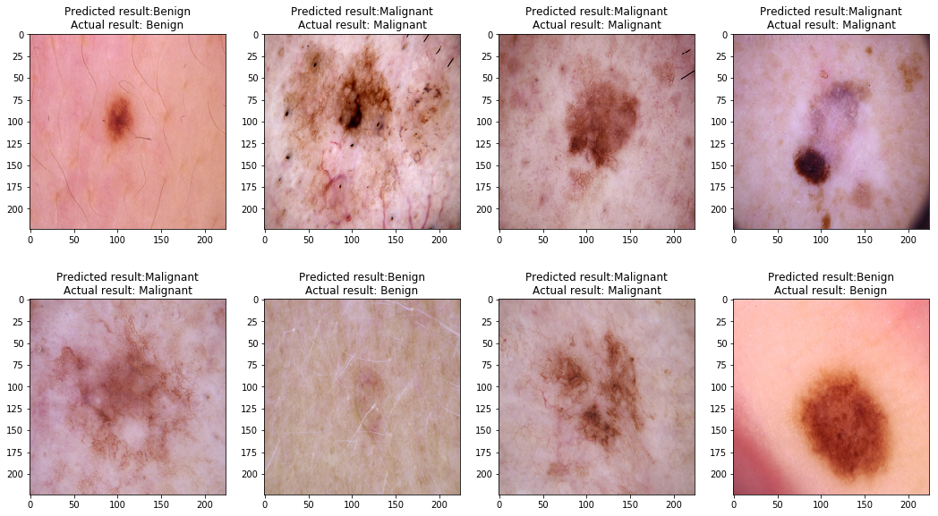
Result sample

Slide 31
REFERENCES
A. Bono, S. Tomatis, and C. Bartoli, The ABCD system of melanoma detection: A spectrophotometric analysis of the asymmetry,border, color, and dimension, "Cancer", vol. 85, no. 1, pp. 72–77, January 1999
G.Argenziano, H. Soyer, S. Chimenti, R. Talamini, R. Corona, F. Sera, and M. Binder, Dermoscopy of pigmented skin lesions: Results of consensus meeting via the Internet Journal of the American Academy of Dermatology, vol. 48, pp. 679–693, 2003
H. Iyatomi, H. Oka, M. Saito, A. Miyake, M. Kimoto, J. Yamagami, S. Kobayashi, A. Tanikawa, M. Hagiwara, K. Ogawa, G. Argenziano, H. P. Soyer, and M. Tanaka, Quantitative assessment of tumour extraction from dermoscopy images and evaluation of computer-based extraction methods for an automatic melanoma diagnostic system Melanoma Research, vol. 16, no. 2, pp. 183–190, 2006
I. Maglogiannis and C. Doukas, Overview of advanced computer vision systems for skin lesions characterization IEEE Trans. on Information Technology in Biomedicine, vol. 13, no. 5, pp. 721–733, 2009
D. Glotsos, et al. "A multiclassifer system for the characterization of normal, infectious, and cancerous prostate tissues employing transrectal ultrasound images,"Computer methods and programs in biomedicine, vol. 97, no. 1, pp. 53-61, 2010.
M. Celebi, H. Kingravi, B. Uddin, H. Iyatomi, Y. Aslandogan, W. Stoecker, and R. Moss, A methodological approach to the classification of dermoscopy images, Computerized Medical Imaging and Graphics, vol. 31, pp. 362–373, 2007

Slide 32
R. Kasmi and K. Mokrani, "Classification of malignant melanoma and benign skin lesions: implementation of automatic ABCD rule," IET Image Processing, vol.10, no.6,pp. 448-455, 2016.
https://arxiv.org/abs/1706.06969
https://medium.com/@RaghavPrabhu/understanding-of-convolutional-neural-network-cnn-deep-learning-99760835f148
https://www.mathworks.com/discovery/convolutional-neural-network.html
https://adeshpande3.github.io/adeshpande3.github.io/A-Beginner's-Guide-To-Understanding-Convolutional-Neural-Networks/

Slide 33
Thank You

